Slide 1
Weekly Meeting
Jan 19, 2022
Gwangwoo Kim

Slide 2
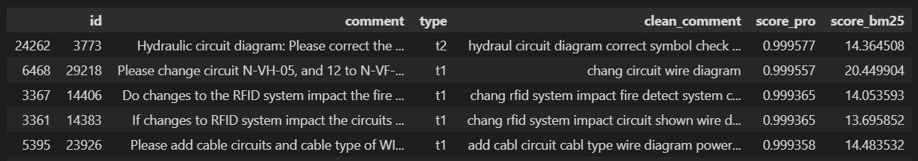
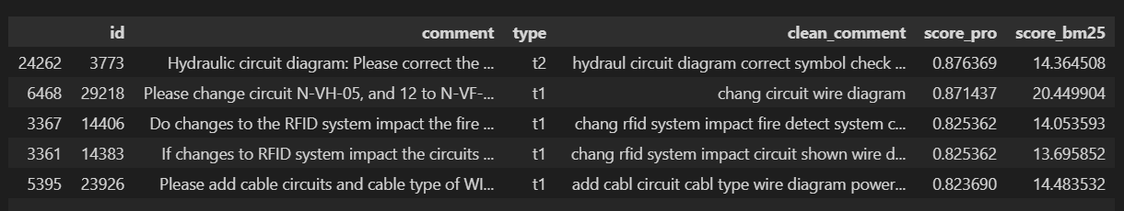
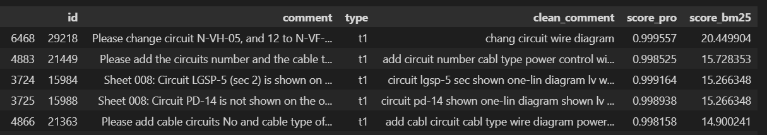

Slide 3
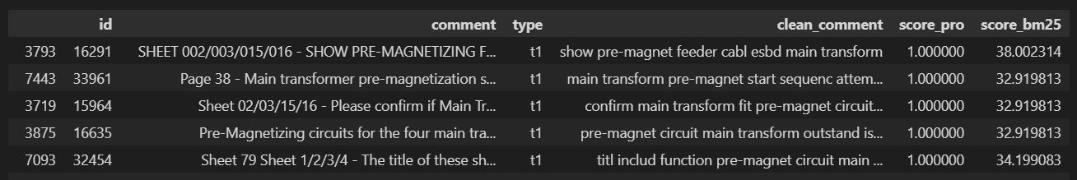
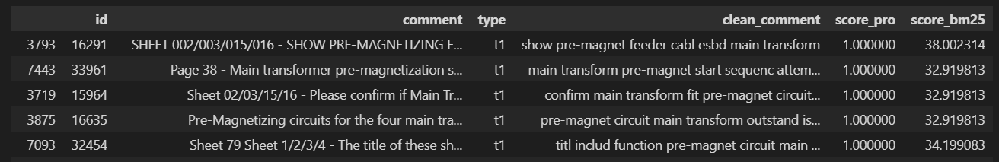
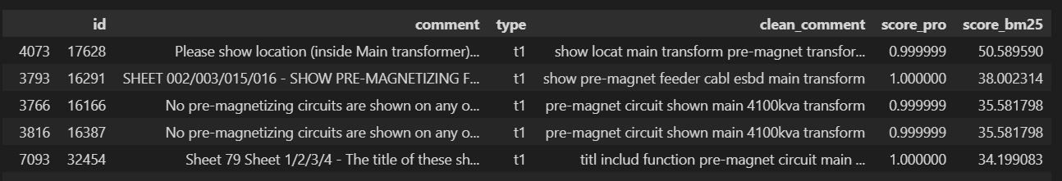

Slide 4
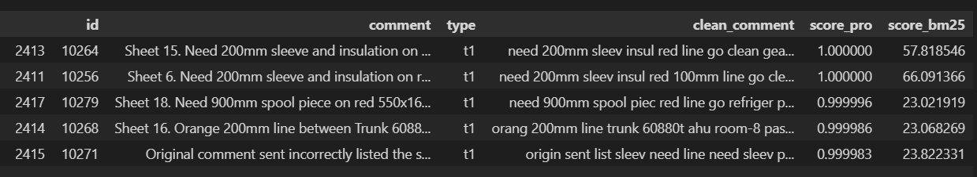
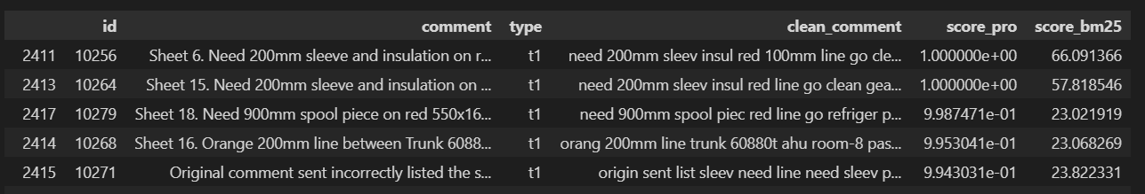
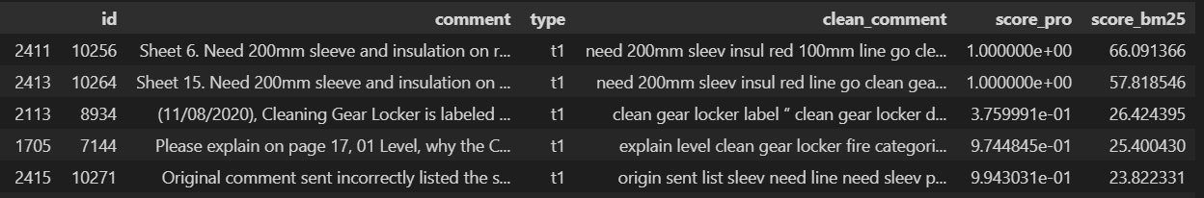

Slide 5
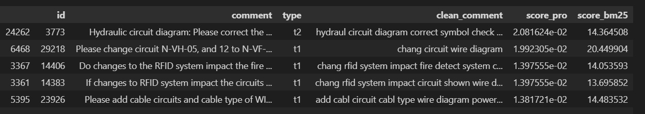
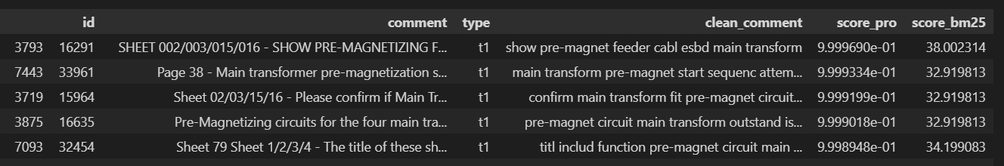
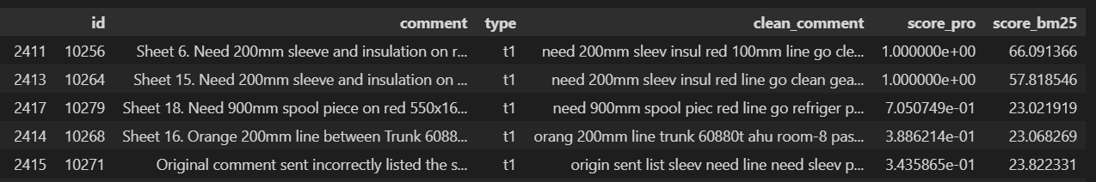
a = 0.000001

Slide 6
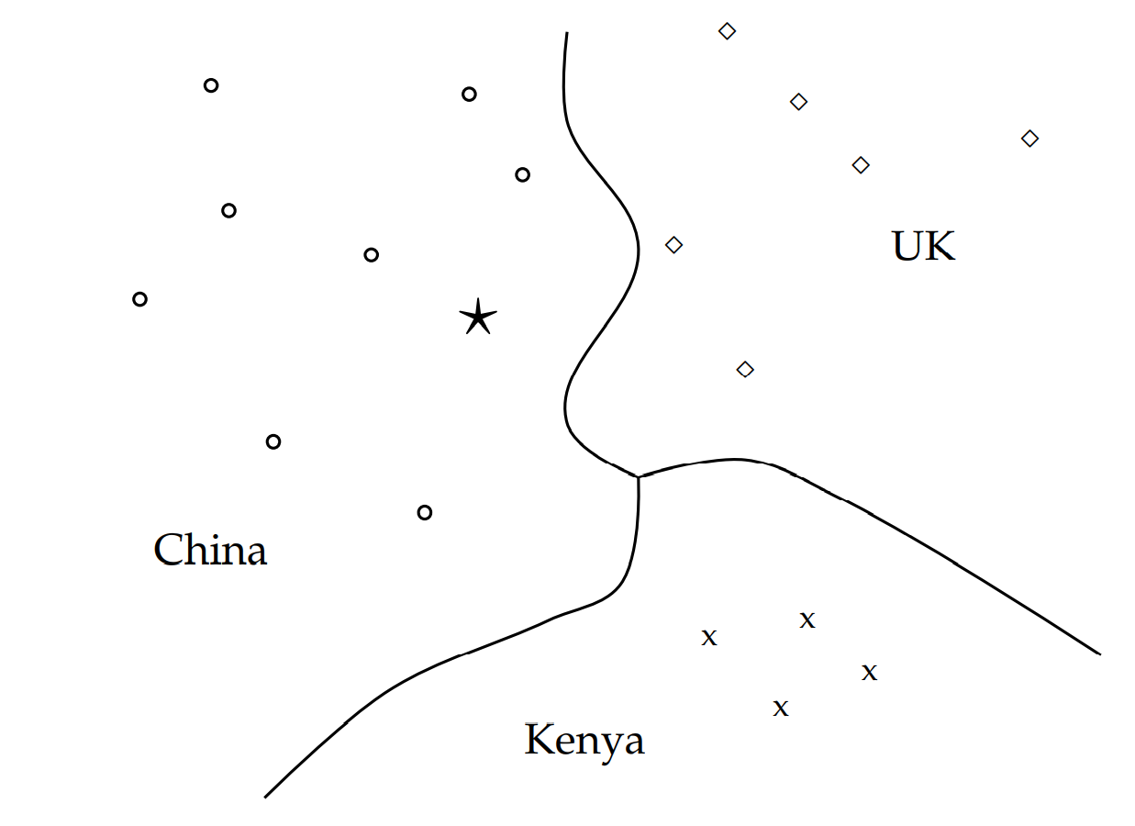
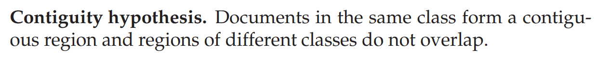
14 Vector space classification

Slide 7
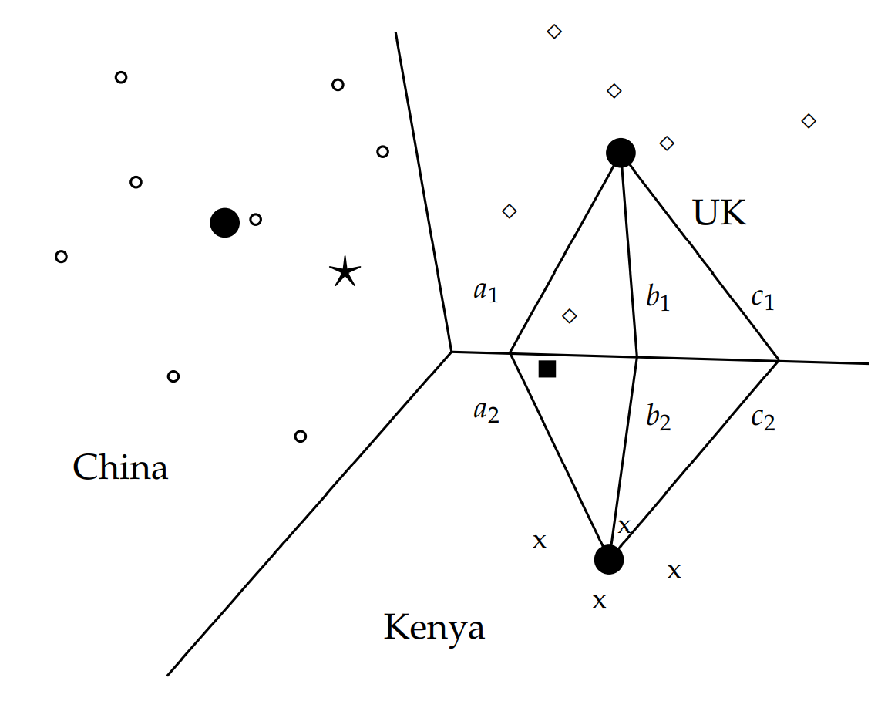
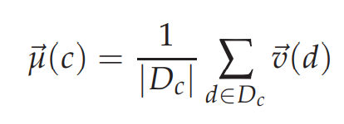

14.2 Rocchio classification
Note that the two assignment criteria will sometimes make different classification decisions.

Slide 8
14.2 Rocchio classification
The solid square just below the boundary between UK and Kenya is a better fit for the class UK since UK is more scattered than Kenya.

Slide 9
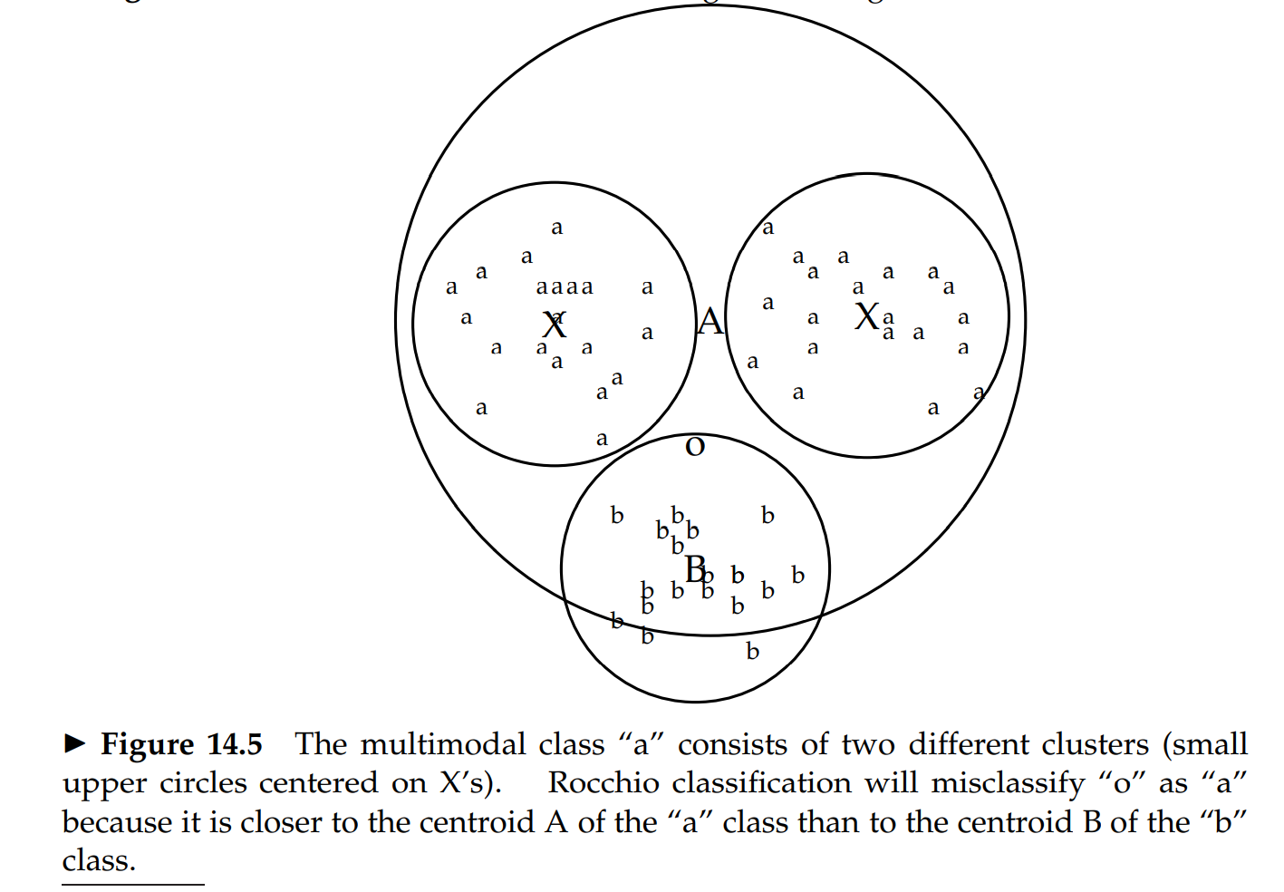
14.2 Rocchio classification
Burma, which changed its name to Myanmar in 1989.

Slide 10
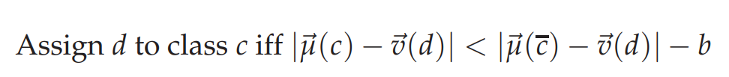

14.2 Rocchio classification
or
c
not c

Slide 11
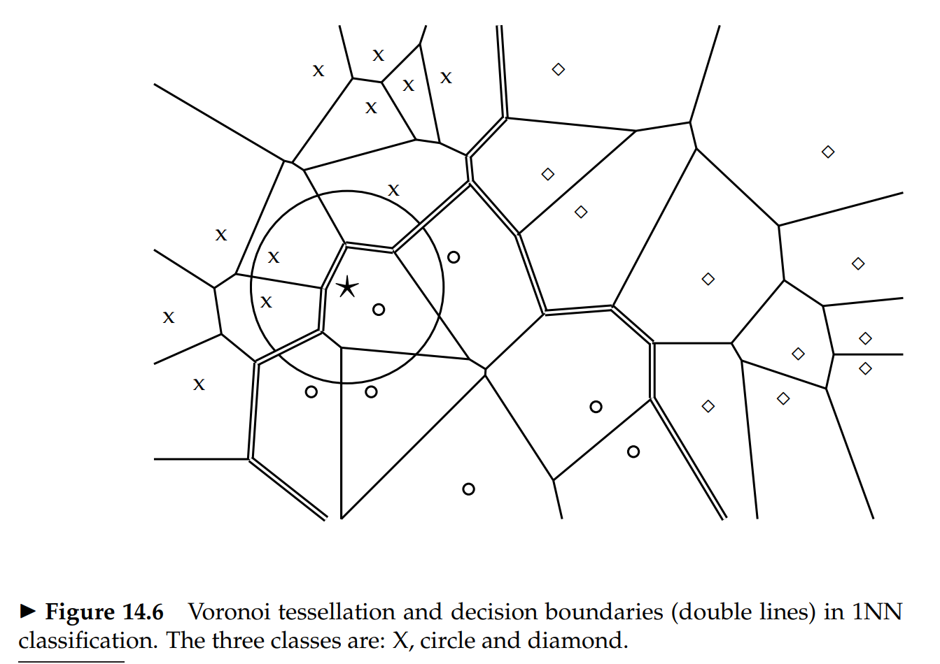
14.3 kNN

Slide 12
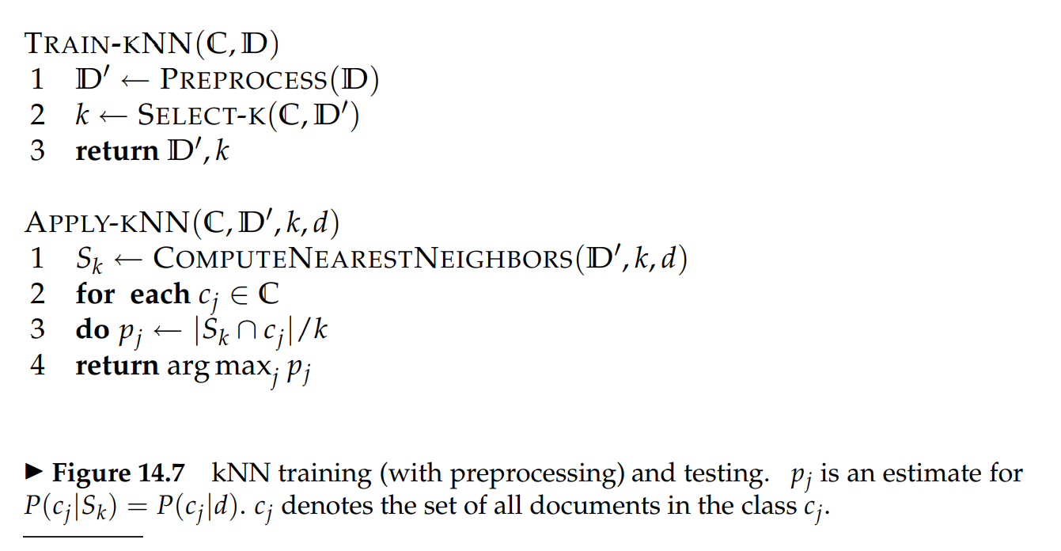
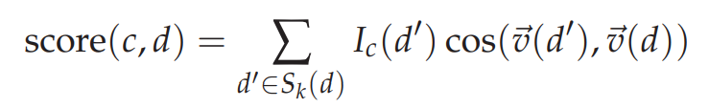
14.3 kNN
<Note>

Slide 13
14.3 kNN
<Remarks>
In fact, if we preselect a value for k and do not preprocess,
then kNN requires no training at all.
2. kNN has a potential advantage for problems with large classes.
3. But in kNN large training sets come with a severe efficiency penalty in classification.
4. kNN handles multimodal classes better than Rocchio.

Slide 14
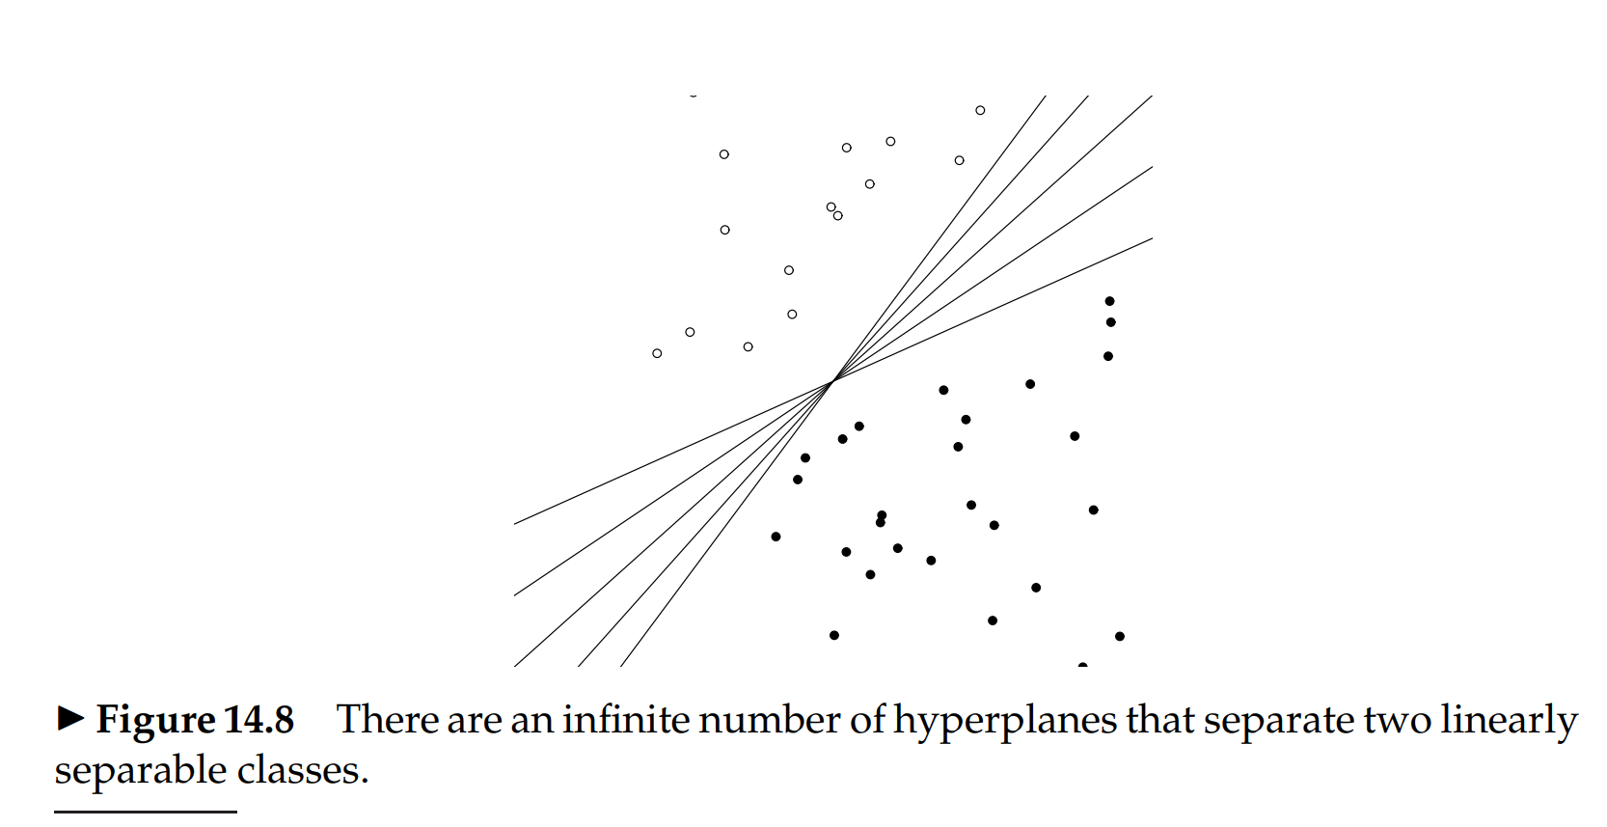
14.4 Linear versus nonlinear classifiers
We will only consider two-class classifiers in this section and define a linear classifier as a two-class classifier that decides class membership by comparing a linear combination of the features to a threshold.

Slide 15
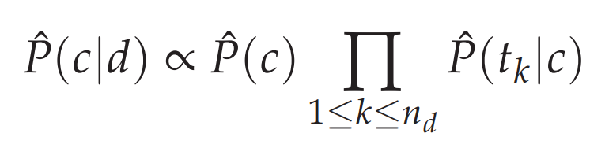
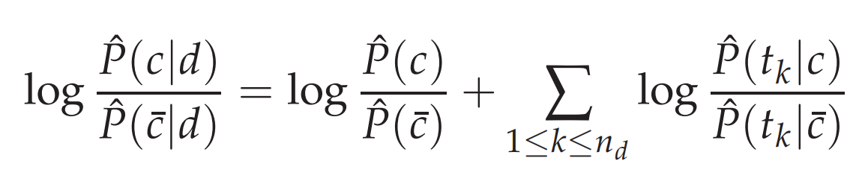



14.4 Linear versus nonlinear classifiers
Example 1 (Rocchio)
Example 2 (Naïve Bayes)
by using log odds
in log space, Naive Bayes is a linear classifier.

Slide 16
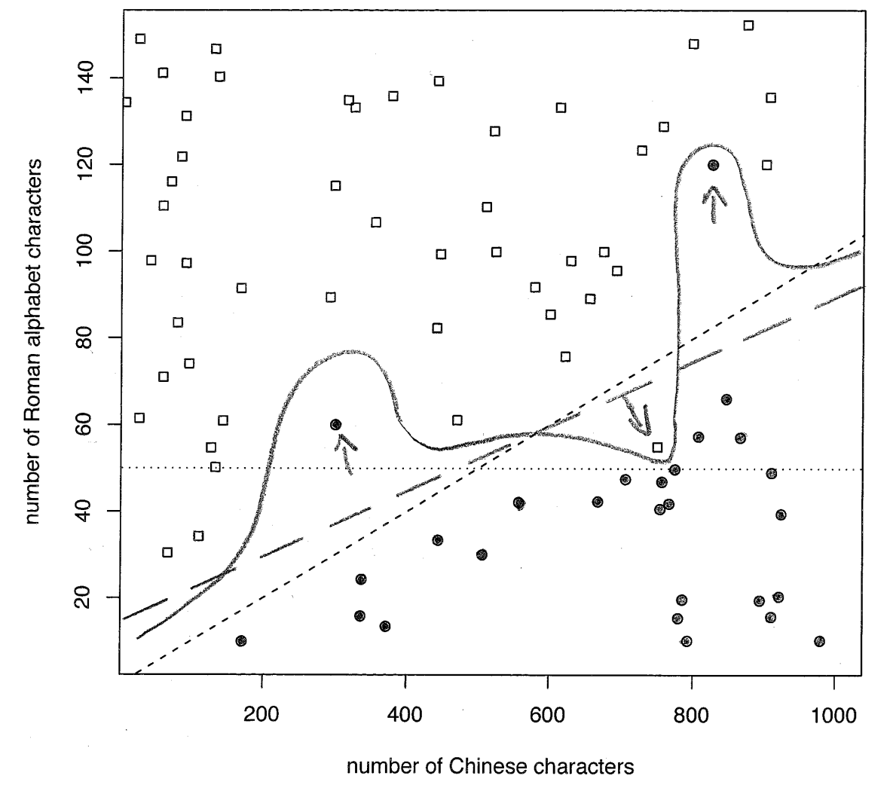
14.4 Linear versus nonlinear classifiers
Noise documents are one reason
why training a linear classifier is hard.
In fact, if linear separability holds,
then there is an infinite number of linear separators

Slide 17
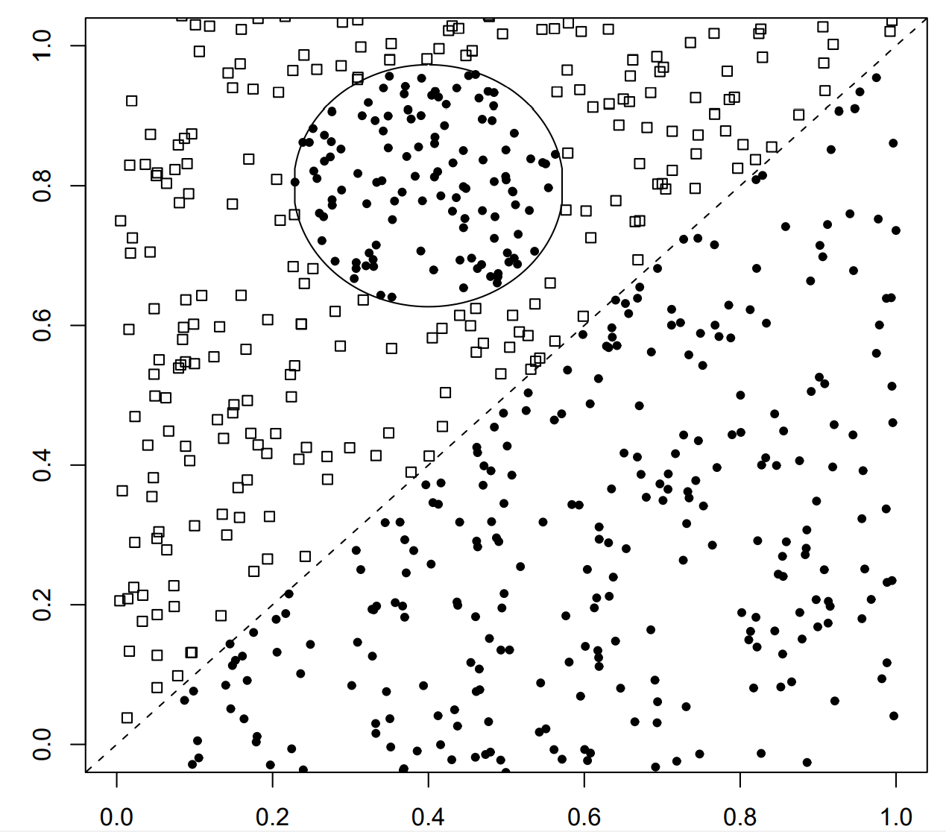
14.4 Linear versus nonlinear classifiers
Example 3 (kNN)
kNN is intuitively not a linear classifier

Slide 18
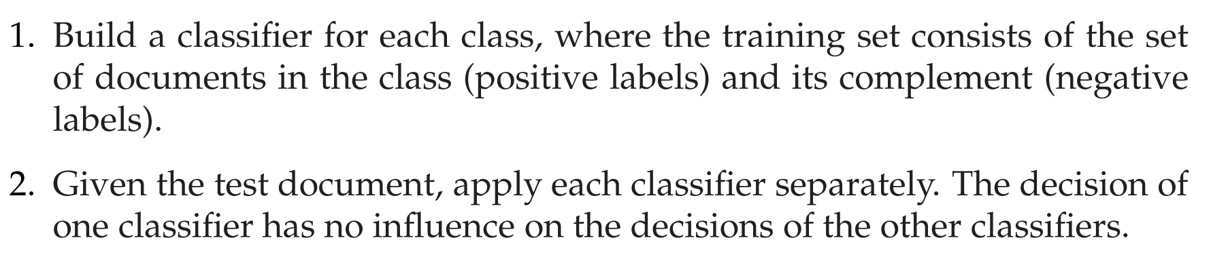
14.5 Classification with more than two classes
any-of, multilabel, or multivalue classification

Slide 19
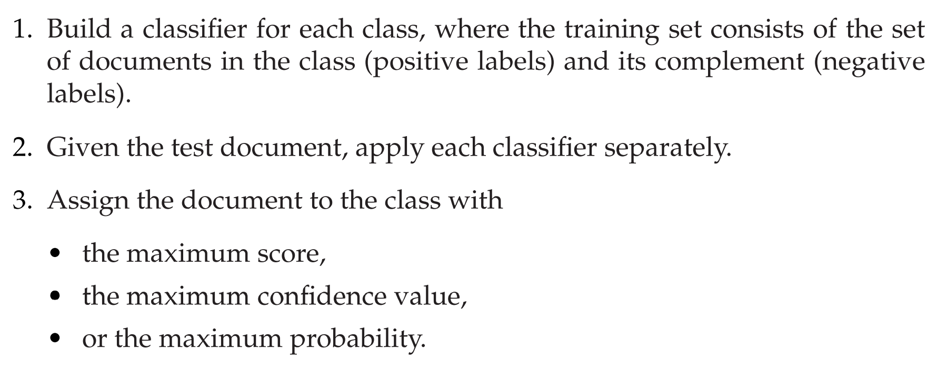
14.5 Classification with more than two classes
one-of classification

Slide 20
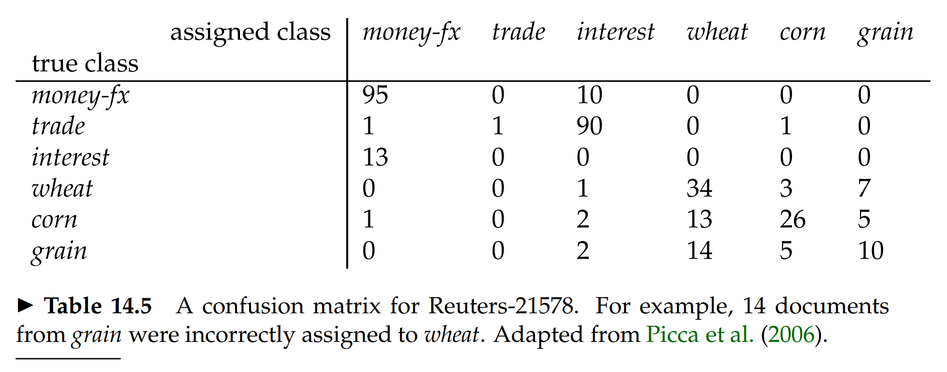
14.5 Classification with more than two classes

Slide 21
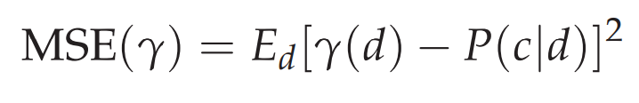
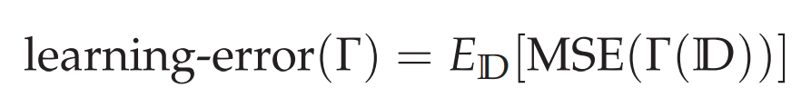
14.6 The bias-variance tradeoff
Q: Should we always use nonlinear classifiers for optimal effectiveness in statistical text classification?
A: Instead look at how well the classifier estimates the conditional probability P(c|d) of a document being in a class.
A learning method Γ is optimal for a distribution P(D) if it minimizes the learning error.
Warning: In general, D does not contain a labeled instance of d!

Slide 22
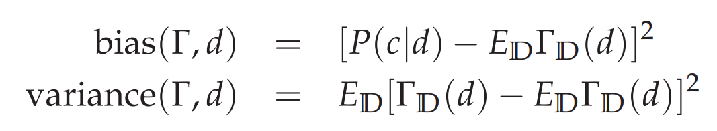
14.6 The bias-variance tradeoff
Linear methods have a high bias for nonlinear problems.
On the other hand, nonlinear methods have low bias.

Slide 23
14.6 The bias-variance tradeoff
Linear learning methods have low variance.
On the other hand, nonlinear methods have high variance.
For example, kNN is sensitive to some noise features.

Slide 24
14.6 The bias-variance tradeoff
One-feature classifier: This classifier uses only one feature,
the number of Roman alphabet characters.
2. Linear classifier.
3. “Fit-training-set-perfectly” classifier.

Slide 25
14.6 The bias-variance tradeoff
It is perhaps surprising that so many of the best-known text classification algorithms are linear. (linear SVMs, regularized logistic regression, regularized linear regression)
With increased dimensionality, the likelihood of linear separability increases rapidly

Slide 26
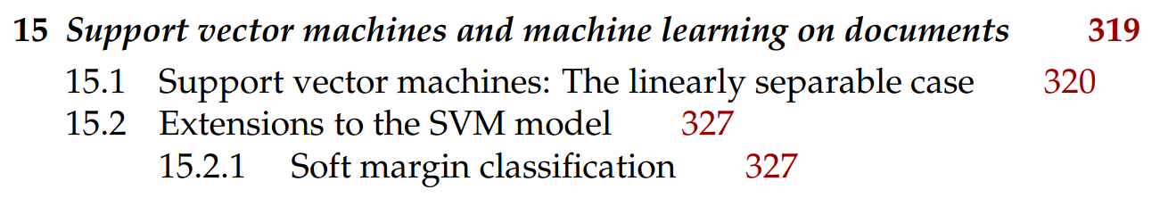
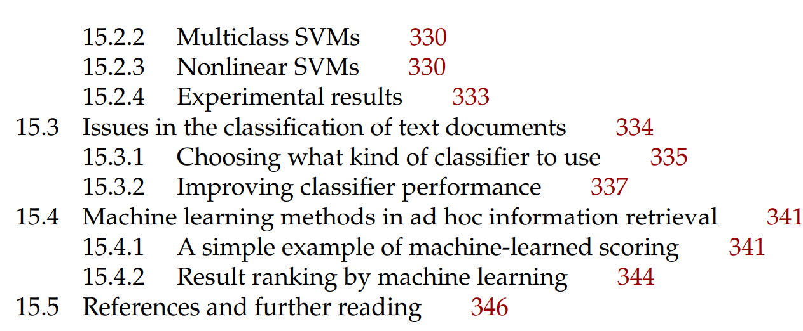
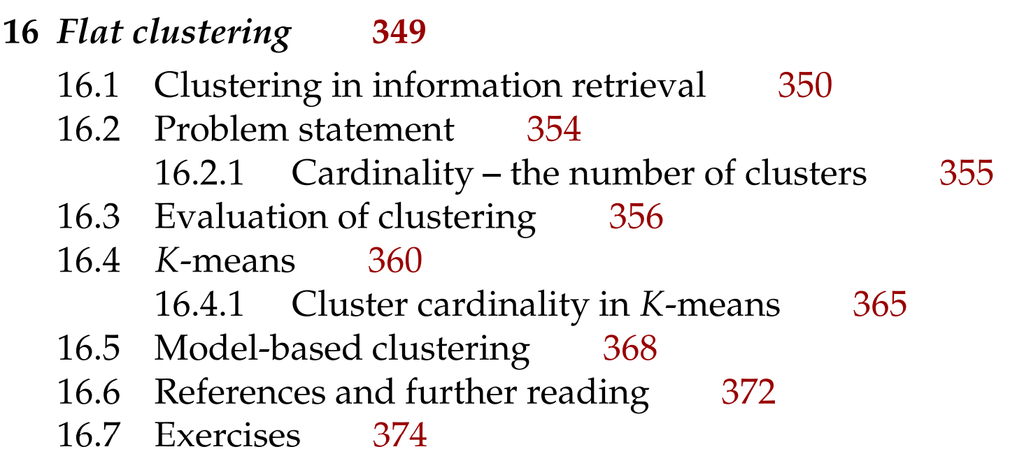
Next

Slide 27
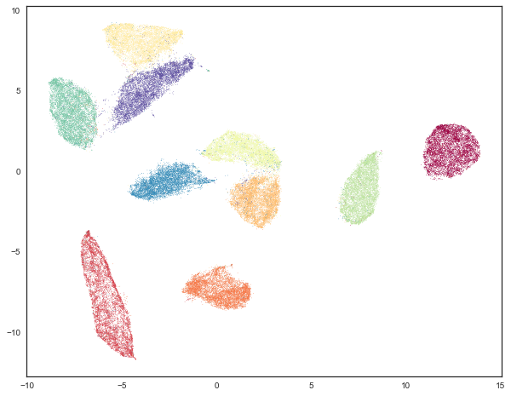
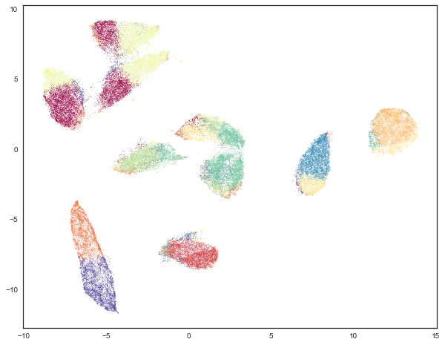
MNIST (UMAP)
MNIST (k-means, k=10)

Slide 28
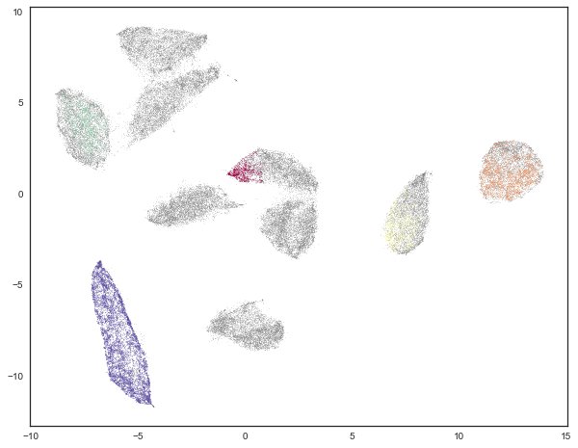
MNIST (HDBSCAN)
MNIST (k-means, k=10)

Slide 29
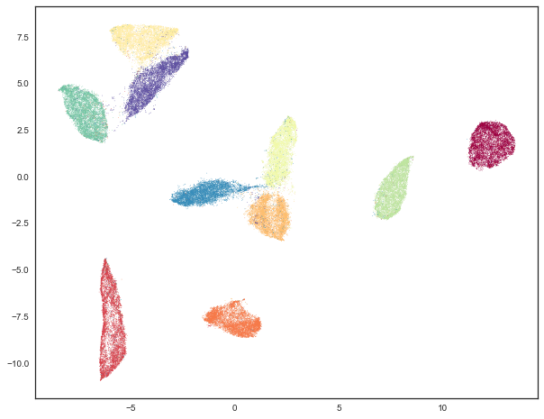
MNIST (HDBSCAN)
MNIST (UMAP, other parameters)
clusterable_embedding = umap.UMAP( n_neighbors=30, min_dist=0.0, n_components=2, random_state=42, ).fit_transform(mnist.data)

Slide 30
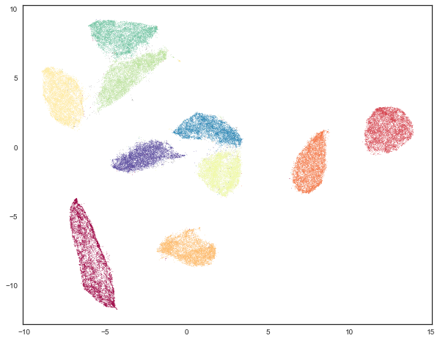
MNIST (HDBSCAN)
99%의 데이터가 clustering 됐음
MNIST (UMAP, other parameters)

Slide 31
